Slide 1

4
Continuous Random Variables and Probability Distributions

Slide 2
OBJECTIVES
Continuous Distribution:
Normal Distribution

Slide 3
The Normal distribution

Slide 4
The Normal Distribution
The normal distribution is the most important one in all of probability and statistics.
Many populations' distributions can be fit by an appropriate normal curve.
Examples:
heights
weights
reaction times in psychological experiments
measurements of intelligence and aptitude
scores on various tests

Slide 5


The Normal Distribution
e ≈ 2.71828
≈ 3.14159

Slide 6
The Normal Distribution
X ~ N( , ²): X is normally distributed with parameters
and ².
E(X) =
V(X) = ²

Slide 7
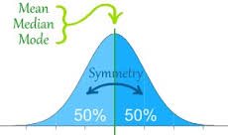
The Normal Distribution

Slide 8
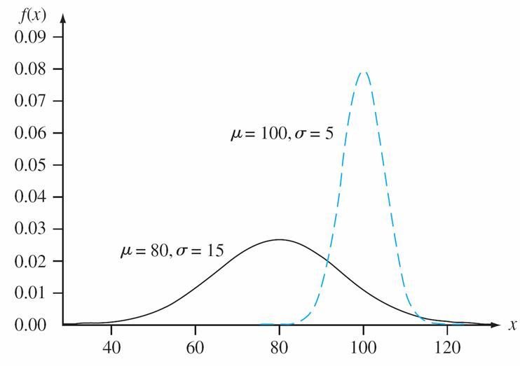
The Normal Distribution

Slide 9
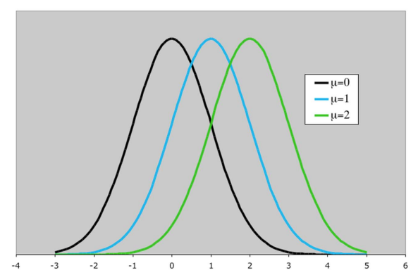
The Normal Distribution
location parameter: changing its value rigidly shifts the
density curve to left or right.

Slide 10
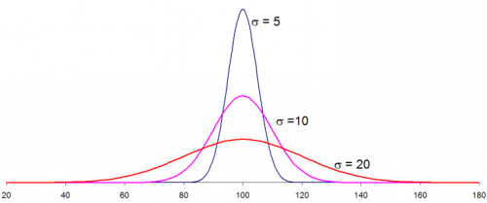
The Normal Distribution
scale parameter: changing its value stretches/compresses
the curve horizontally without changing the
basic shape.

Slide 11
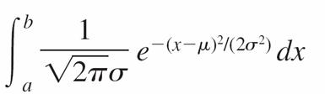
The Normal Distribution
If X ~ N( , ²)
P(a X b) =

Slide 12

The Standard Normal Distribution
Z ~ N( = 0, ² = 1)

Slide 13
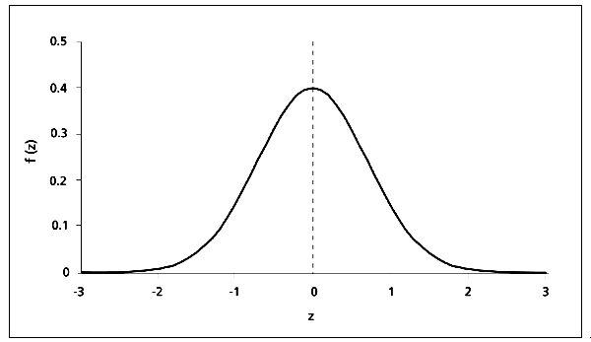
The Standard Normal Distribution

Slide 14
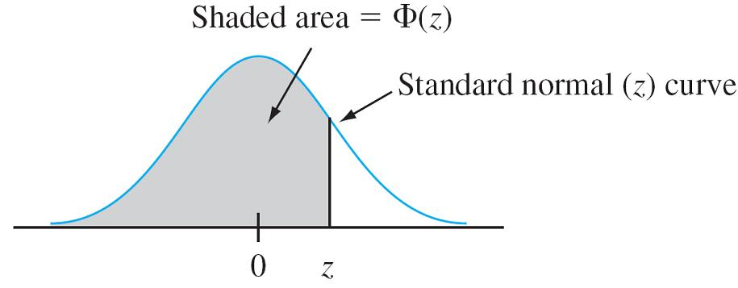
The Standard Normal Distribution
CDF F(z) = = P(Z z)
= the area under the standard normal
density curve to the left of z.

Slide 15

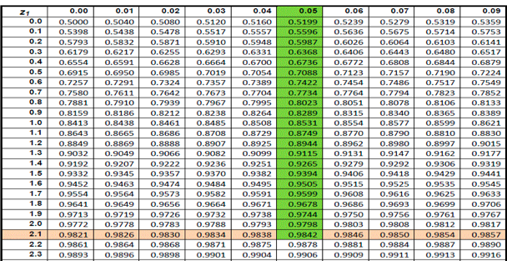
The Standard Normal Distribution

Slide 16
Example
Let’s determine the following standard normal probabilities:
(a) P(Z 1.25), (b) P(Z > 1.25),
(c) P(Z –1.25), (d) P(–.38 Z 1.25)
(e) P(Z 5)

Slide 17

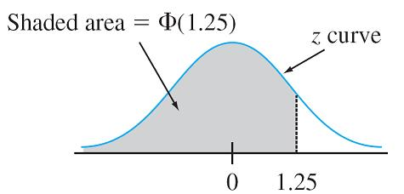
Example
cont’d
a. P(Z 1.25) = ((1.25) = .8944

Slide 18
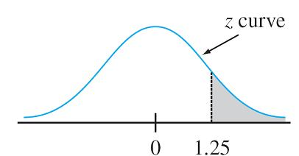
Example
cont’d
b. P(Z > 1.25)
P(Z > 1.25) = the area under the z curve to the right of 1.25
= 1 – P(Z 1.25)
= 1 – (1.25)
= 1- 0.8944 = 0.1056

Slide 19
Example
cont’d
c. P(Z –1.25) = (–1.25), a lower-tail area.
= .1056.
By symmetry of the z curve, this is the same answer as in part (b).

Slide 20
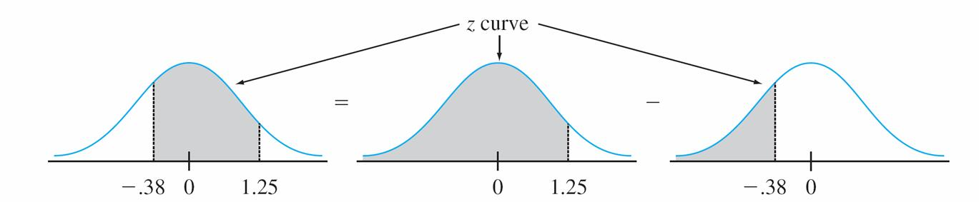
Example
cont’d
d. P(–.38 Z 1.25) = 0.5424

Slide 21
Example
cont’d
e. P(Z 5) = Ф(5)
The last entry in that row is Φ(3.49) = .9998.
Therefore we conclude that P(Z 5) ≈1.

Slide 22
Percentiles of the Standard Normal Distribution

Slide 23
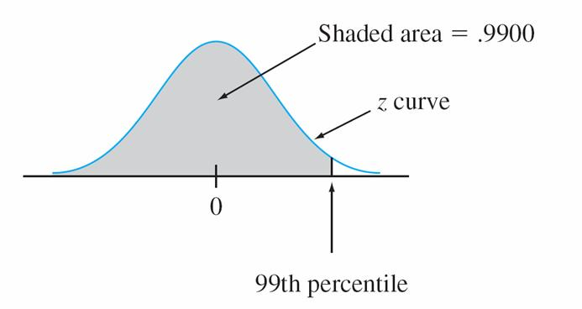
Example
The 99th percentile

Slide 24
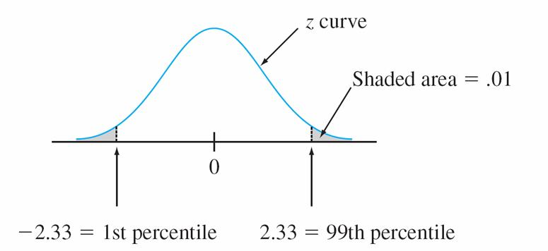
Example
cont’d
The relationship between the 1st and 99th percentiles

Slide 25
Percentiles of the Standard Normal Distribution
Find the 95th percentile.
Although .9500 does not appear, both .9495 and .9505 do, corresponding to z = 1.64 and 1.65, respectively.
Since .9500 is halfway between the two probabilities that do appear, we will use 1.645 as the 95th percentile and –1.645 as the 5th percentile.

Slide 26
z Notation for z Critical Values

Slide 27
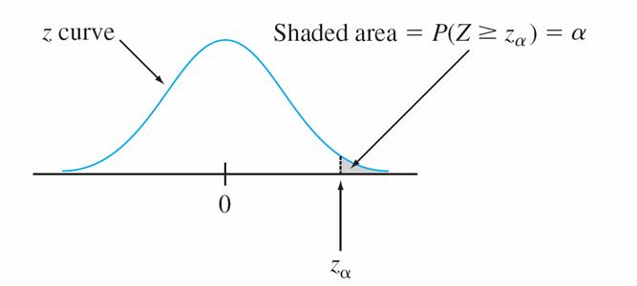
z Notation for z Critical Values
For example,
z_{.10} captures upper-tail area .10
z_{.05} captures upper-tail area .05

Slide 28
Z Notation for z Critical Values
Since of the area under the z curve lies to the right of z , 1 – of the area lies to its left.
Thus z is the 100(1 – )th percentile of the standard normal distribution.
By symmetry the area under the standard normal curve to the left of –z is also .

Slide 29
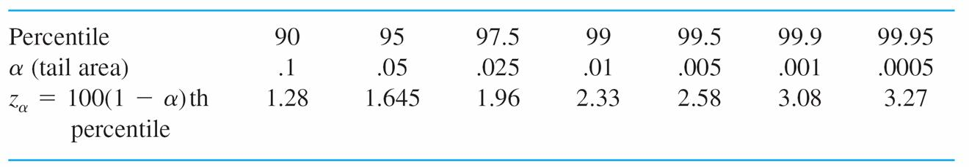
z Notation for z Critical Values
The most useful Standard Normal Percentiles and Critical
Values

Slide 30
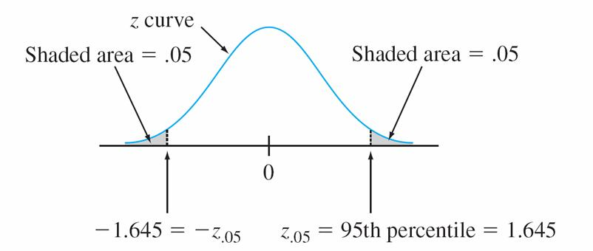
Example
z_{.05} = 95th percentile of the standard normal distribution, so z_{.05} = 1.645.

Slide 31
Nonstandard Normal Distributions

Slide 32
Nonstandard Normal Distributions
When X ~ N( , ²), probabilities involving X are computed by “standardizing.”
The standardized variable is

Slide 33
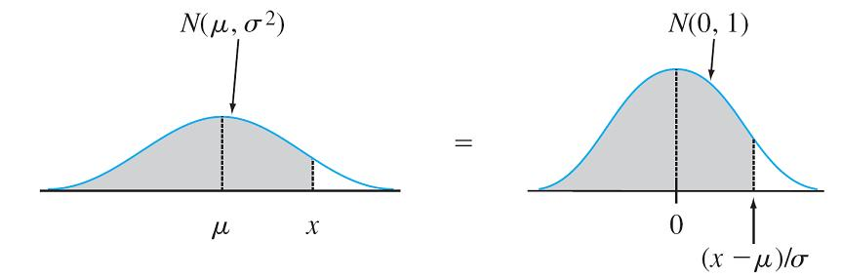
Nonstandard Normal Distributions
Equality of nonstandard and standard normal curve areas

Slide 34
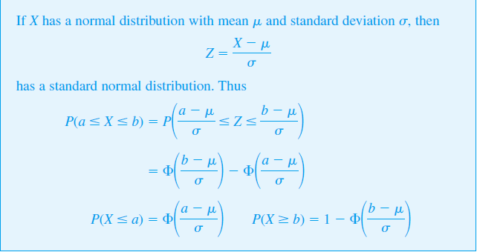
Nonstandard Normal Distributions

Slide 35
Example
The time that it takes a driver to react to the brake lights on a decelerating vehicle is critical in helping to avoid rear-end collisions.
The reaction time ~ N(1.25, .46).
What is the probability that reaction time is between 1.00 sec and 1.75 sec?

Slide 36
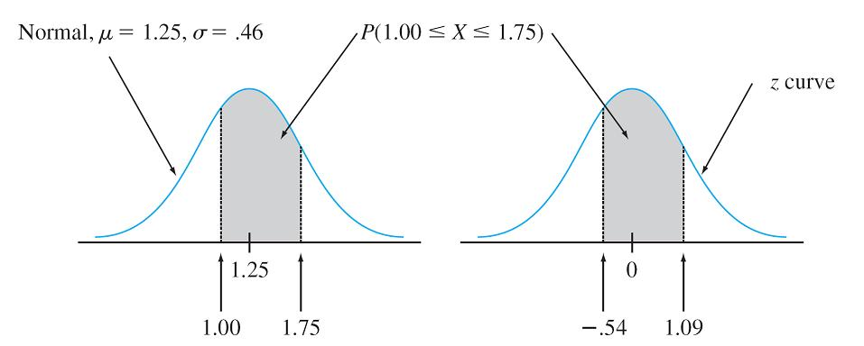
Example
cont’d

Slide 37
Example
cont’d
Similarly, if we view 2 sec as a critically long reaction time, the probability that actual reaction time will exceed this value is

Slide 38
Percentiles of an Arbitrary Normal Distribution

Slide 39
Example
A data collected from an experiment with a specified initial crack length and number of loading cycles has a normal distribution with mean value 5.496 mm and standard deviation .067 mm for the rv X = final crack depth.
For this model, what value of final crack depth would be exceeded by only .5% of all cracks under these circumstances?

Slide 40
Example
cont’d
Let c denote the requested value.
Then the desired condition is that P(X > c) = .005, or, equivalently, that P(X < c) = .995.
Thus c is the 99.5th percentile of the normal distribution with
µ = 5.496 and = .067.

Slide 41
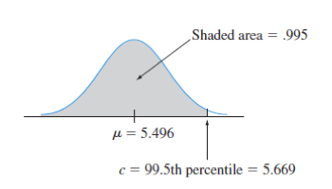
Example
cont’d
The 99.5th percentile of the standard normal distribution is 2.58, so

Slide 42
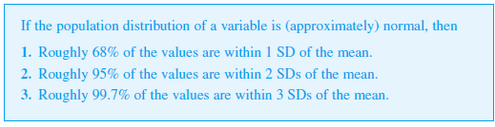
Empirical rule

Slide 43
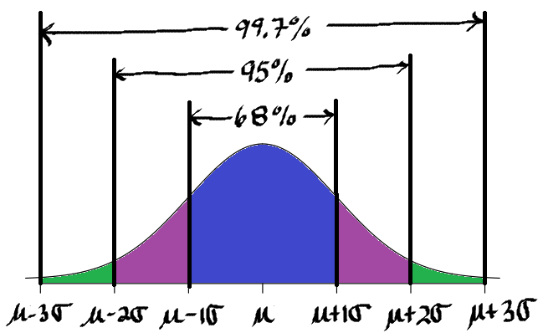
Empirical rule

